Slide 1
Opioids Pain management & Substance abuse
Maria Grigorova 9th group

Slide 2
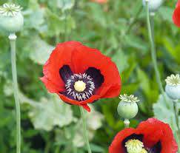
What are prescription opioids?
Used to manage moderate to severe acute pain syndromes, such as pain from trauma, postoperative pain or chronic pain.
Derived from the opium poppy plant.
Work on the nervous system to provide pleasurable feelings and pain alleviation.
A varied category of natural or semisynthetic compounds that bind to mu, kappa, and delta-opioid receptors in the neurons and have morphine-like pharmacological effect.
Papaver somniferum

Slide 3
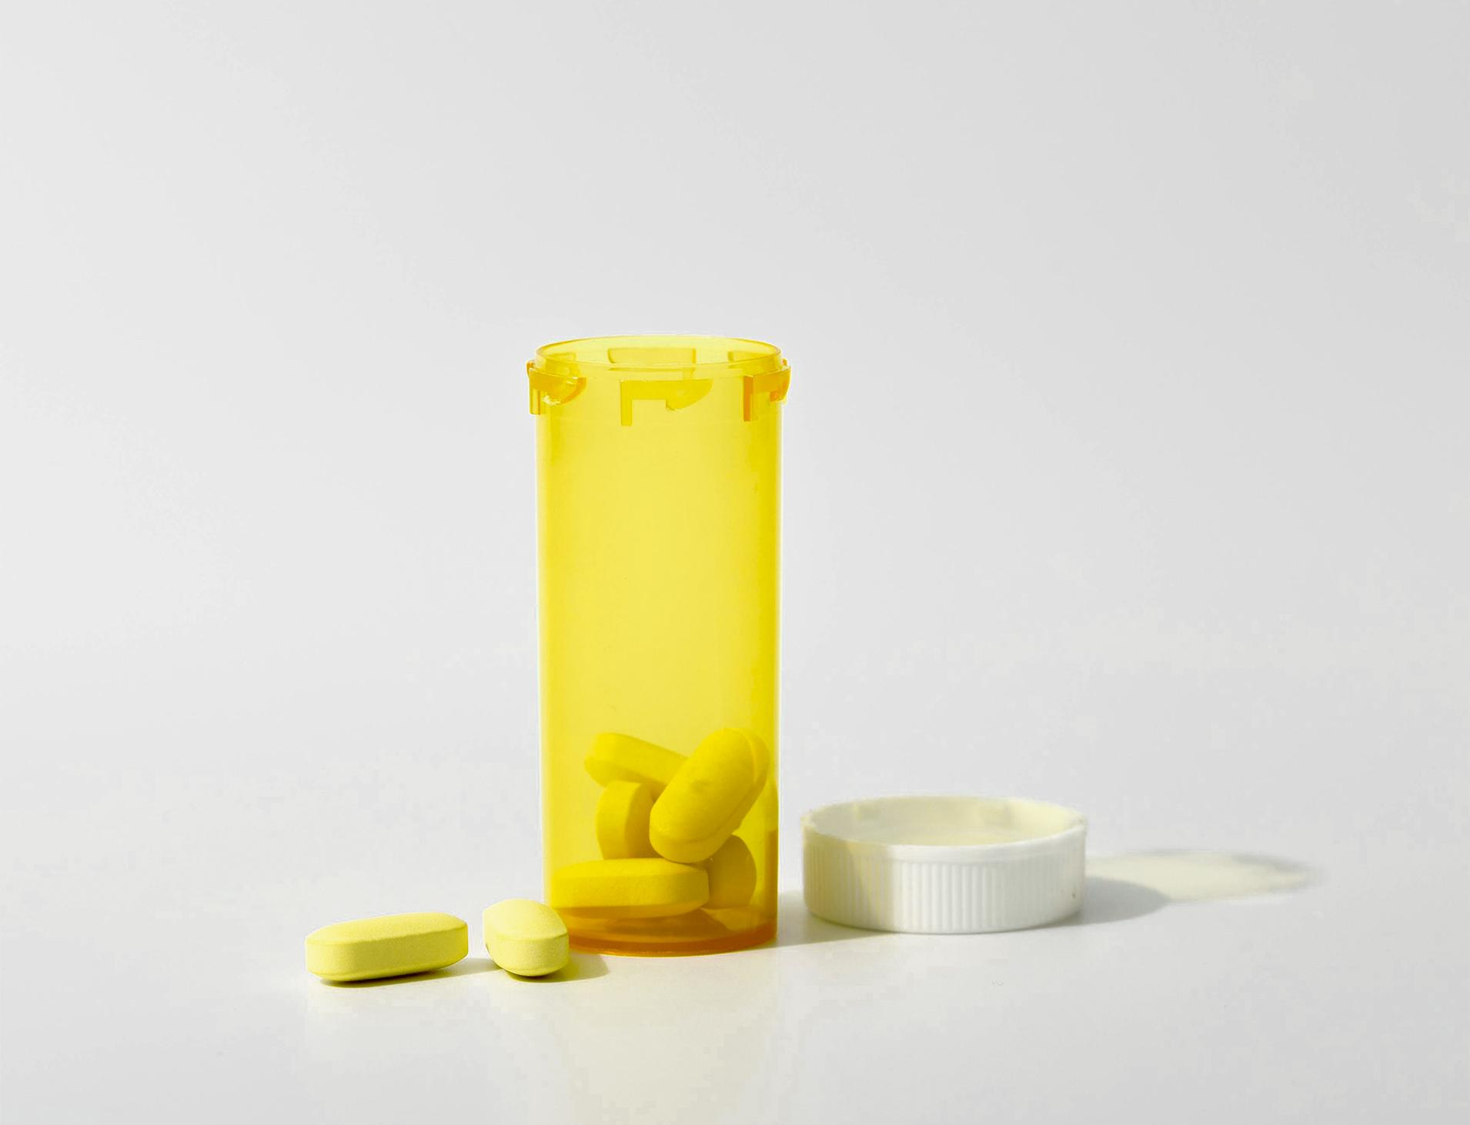
Commonly prescribed opioids
hydrocodone (Vicodin® )
oxycodone (OxyContin® , Percocet® )
oxymorphone (Opana® )
morphine (Kadian® , Avinza ®)
buprenorphine (Subatex ®)
methadone (Dolophine®)
codeine
fentanyl, a synthetic opioid 50-100 times more potent than morphine
heroin, an illegal drug

Slide 4
Categories of painkillers
Lesser strength painkillers - paracetamol or ibuprofen
Weak opioids - codeine
Strong opioids-tramadol, buprenorphine, methadone, fentanyl,
morphine, oxycodone
Natural opiates- Opium
Semisynthetic opiates- heroin, hydrocodone, and oxycodone

Slide 5
Side effects
Common side effects:
If the dose is too high:
Constipation
Nausea
Drowsiness and tiredness
Confusion
Low blood pressure
Hallucinations
Deep, slow breathing
Slurred speech

Slide 6
Work on opioid receptors (mu, kappa or delta) Limbic parts of the brain are critical for mood regulation Reduce the release of excitatory neurotransmitters (Norepinephrine and glutamate) - inhibit voltage-gated Ca2 currents . Serotonin (5-hydroxytryptamine) can either mediate low pain signals or facilitate pain signaling.
How do opioid analgesics work?

Slide 7
TOLERANCE and DEPENDENCE
Tolerance-The state in which a patient needs a higher dose of opioids to achieve the same level of analgesic relief
Withdrawal symptoms:
Feeling anxious or agitated
Insomnia
Sweating
Muscle pains
Feeling sick
Diarrhoea
Cramps
"pseudo-addiction"
Physical dependence is a typical compensatory response to long-term opioid usage
not uncommon
develops after only a few days of prolonged opioid usage
indicated by "abstinence-induced" withdrawal symptoms.
can be clinically addressed

Slide 8
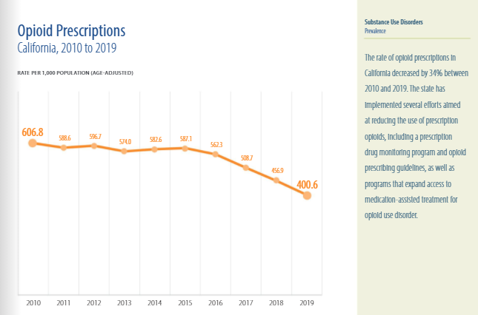
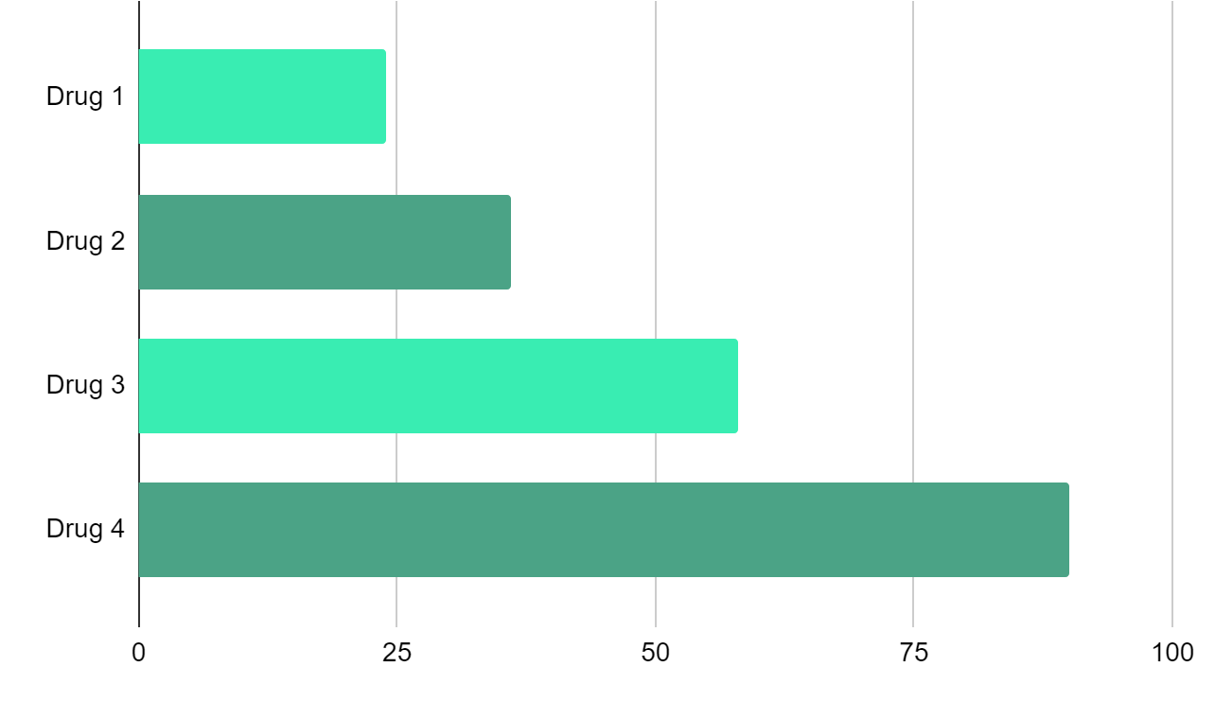
FINDINGS
TREND
MOST ABUSED DRUGS
Morphine (Kadian® , Avinza ®)
Oxycodone (OxyContin ®)
Buprenorphine (Subatex®)
Fentanyl (Duragesic®)
The rate of opioid prescriptions in pharmacies decreased by 34% between 2010 and 2019.

Slide 9
The problem with opioids
The opioid crisis- "epidemics" of under-treatment of legitimate pain and over-prescription of opioids
A "medical problem“ turned into a public health disaster and a huge societal concern.
The first crisis is opioid abuse- widespread prescription of opioids.
The second is uncontrollable pain that cannot be properly addressed.
The treatment of individuals in agonizing pain was so bad that the World Health Organization issued a report in 1988 and pain control became a ‘fundamental human right’.

Slide 10
Misuse, abuse and addiction
The majority of individuals who are administered opioids for pain relief do not develop an addiction to them.
Misuse
"drug liking" scales
Basic themes
Opioid misuse
As higher doses are required to obtain the same therapeutic efficacy, higher doses may be needed to achieve the same rewarding effect
oxycodone is far more "loved" than buprenorphine
skipping doses on good days and doubling up on bad days
using opioids to control stress or enhance mood
using opioids to get high

Slide 11
Causes and Inheritance
OUD (opioid use disorder)
Non-genetic factors
Genetic factors
Caused by a mix of genetic, environmental, and lifestyle factors.
A history of substance abuse
depression or psychiatric problems
childhood abuse
certain personality features, such as impulsivity
When opioids bind to opioid receptors, a sequence of chemical changes occur within and between neurons, resulting in feelings of pleasure and pain alleviation.
The OPRM1 gene produces the main receptor (mu) for most opioid medications.

Slide 12
Misuse of prescription opioids affects:
More than 760, 000 people died since 1999 from a drug overdose. Two out of three drug overdose deaths in 2021 involved an opioid.
In 2019, an estimated 10.1 million people aged 12 or older misused opioids. Specifically, 9.7 million people misused prescription pain relievers and 745,000 people used heroin.
More than 2 million Americans &15 million people worldwide each year.

Slide 13
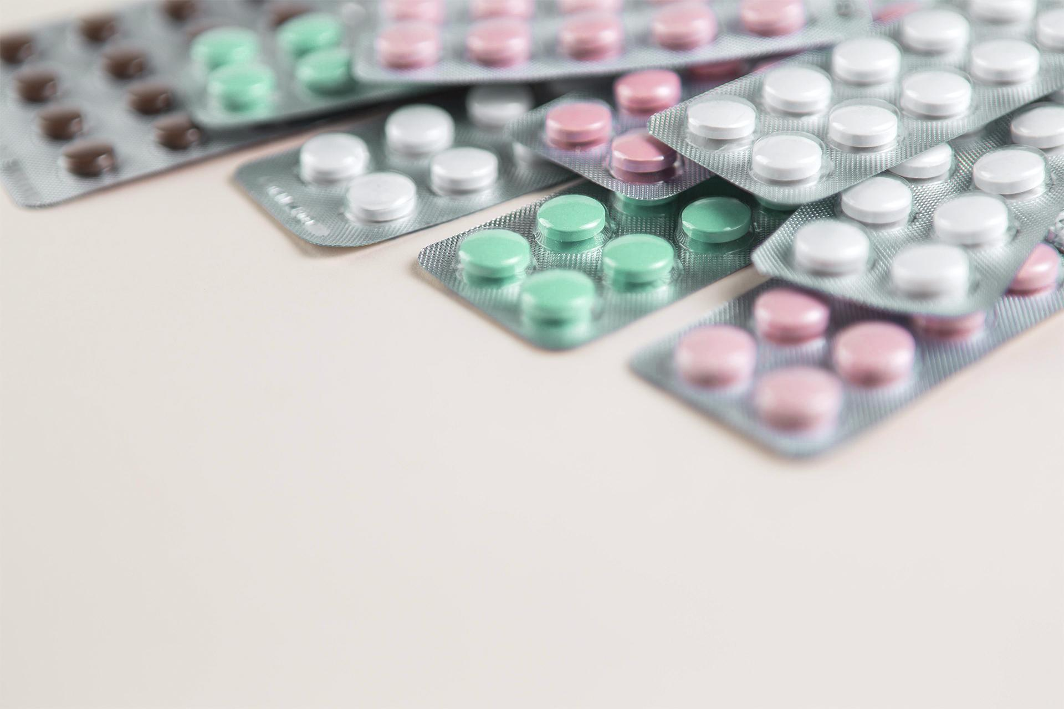
Opioid addiction?
Chronic illness
High risk of creating addiction in certain people
Opioids alter brain chemistry and lead to drug tolerance
withdrawal symptoms (muscle cramping, diarrhea, and anxiety).
The dopamine circuit determines how receptive a person is to opioids and antidepressants
Only a tiny number of those who use opioids for a long time develop the compulsive, ongoing need for the medication

Slide 14
Common Signs of Opioid Addiction
01
02
03
04
05
06
The inability to control opioid use
Uncontrollable cravings
Drowsiness
Changes in sleep habit
Weight loss
Frequent flu-like symptoms
Lack of hygiene
Isolation from family or friends

Slide 15
OVERDOSE
Respiration slows or stops, resulting in unconsciousness and death
A concern with both legal, illegal opioids and opioids coupled with tranquilizers called benzodiazepines.
Overdoses are caused by the agonist effects of opioids on the mu-opioid receptor, found on neurons that control respiration.
If delivered quickly enough after an overdose, the MOR antagonist naloxone can reverse it.
The National Institute on Drug Abuse (NIDA) developed a user-friendly intranasal naloxone formulation (Narcan Nasal Spray).

Slide 16
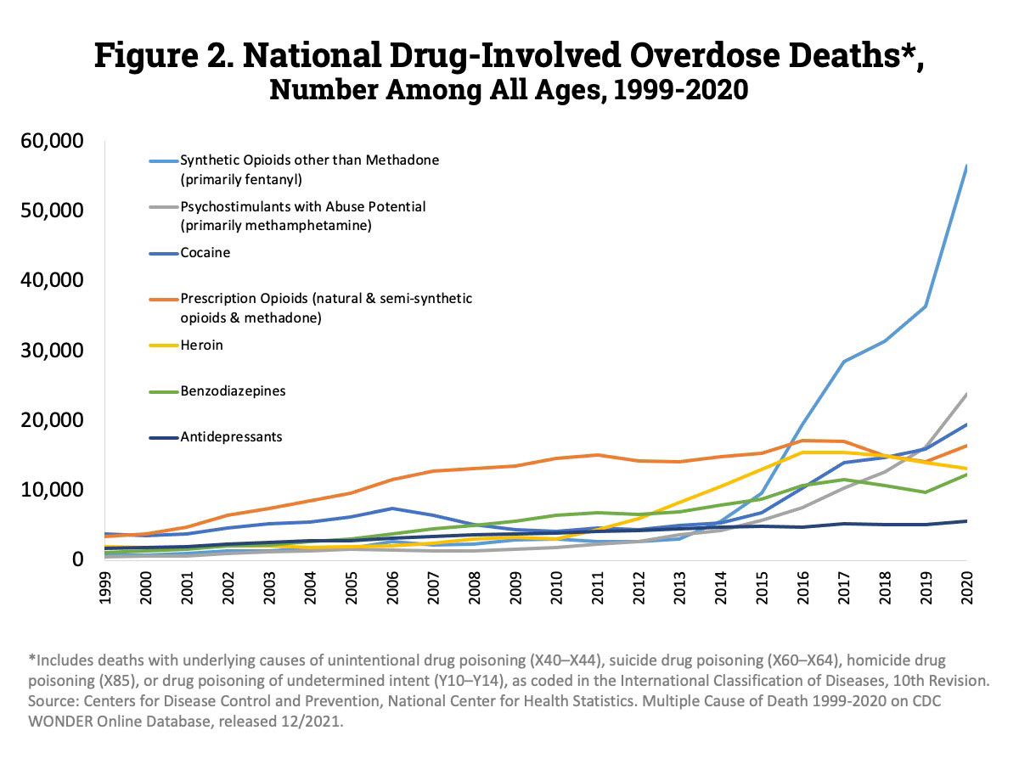

Slide 17
Treatment of OUD
Medications:
Methadone
Buprenorphine
extended-release naltrexone
Lowering illicit opioid use, relapse risk & overdoses
Psychological assistance
Lofexidine - reduces withdrawal symptoms.
Vaccines, which produce antibodies to prescription opioids, heroin
Monoclonal antibodies against highly strong synthetic opioids (e.g., fentanyl)

Slide 18
Chronic Pain Treatments that aren't Addictive
It’s our turn to develop better ones!
Pain relievers such as acetaminophen, ibuprofen, and naproxen
Some medications that are also used for depression or seizures
Physical therapy and Cognitive behavioral therapy

Slide 19
THANK YOU FOR YOUR ATTENTION!

